Slide 1
INTRODUCTION
TO
DESKTOP SUPPORT
Chapter 1

Slide 2
INTRODUCTION TO DESKTOP SUPPORT
Chapter 1: Introduction to Desktop Support
Identify your support role in an organization’s tier structure
Identify the traits of a successful desktop technician
Identify basic troubleshooting techniques
Notes:
Briefly describe the topics covered in the chapter. The focus of this chapter is introducing the jobs a desktop support technician (DST) might hold and the traits the DST must possess.

Slide 3
THE END USER’S LEVEL OF EXPERTISE
Chapter 1: Introduction to Desktop Support
Understand how to treat users of different skills
  Highly experienced
  Generally experienced
  Targeted experience
  No experience
Users might have had bad support experiences in the past
Notes:
Go over the methods for handling users of different experience levels. Talk about the value of expert users.

Slide 4
TRAITS OF A QUALIFIED DST
Chapter 1: Introduction to Desktop Support
Excellent customer service skills
Talent for communicating
Ability to multitask and stay calm under pressure
Technical aptitude
Capacity to solve problems
Notes:
Talk to the class about these skills and different ways they are represented.
Class Discussion: Ask your students to talk about other skills they think might be valuable.

Slide 5
CORPORATE TIER STRUCTURE
Chapter 1: Introduction to Desktop Support
Tier 4, architect
Tier 3, engineer
Tier 2, administrator
Tier 1, help desk
Notes:
Talk about the responsibilities of different tiers. Emphasize that students will likely be working in tier 1 to begin with.

Slide 6
TIER 1 JOB TITLES
Chapter 1: Introduction to Desktop Support
Common tier 1 entry-level job titles:
  Call center support representative
  Customer service representative
  Help desk specialist (or technician)
  Product support specialist
  PC support specialist

Slide 7
TIER 2 AND HIGHER JOB REQUIREMENTS
Chapter 1: Introduction to Desktop Support
Tier 2 and higher job requirements:
  Define and solve problems
  Educate the user on how to avoid the problems in the future
  Install, configure, and upgrade software
  Monitor and maintain systems
  Document calls
Notes:
Discuss the tasks that are performed by tier 2 and higher employees. Compare these tasks to those of a tier 1, help desk employee, discussed in the previous slide. Be sure to discuss service level agreements. Provide examples if possible.

Slide 8
TELEPHONE CALL CENTER TIER STRUCTURE
Chapter 1: Introduction to Desktop Support
Tier 4: 4+ years of experience
Tier 3: 1 to 2 years of experience
Tier 2: 6 months to 1 year of experience
Tier 1: Less than 6 months of experience
Notes:
Go over responsibilities at each tier level. Students will work in tier 1 or 2, depending on experience level.

Slide 9
REPAIR SHOPS AND PRIVATE BUSINESSES
Chapter 1: Introduction to Desktop Support
More hands-on computer work than in a call center
Less likely to work from scripts than in a call center
Should consider earning A+ or similar hardware certification

Slide 10
INTERNET SERVICE PROVIDERS (ISPS)
Chapter 1: Introduction to Desktop Support
Companies that provide Internet access
DSTs at ISPs primarily provide telephone support to customers
Calls typically center around Internet connectivity and applications
Notes:
Explain some common tasks a DST working at an ISP might face. Students might need additional training in networking technologies and Web design. Remind students of the Maintaining and Troubleshooting Applications on a Microsoft Windows XP Platform for Desktop Support Technicians (70-272) exam, which focuses more on some Internet applications, such as Microsoft Internet Explorer and e-mail clients.
Class Discussion: Ask your students to talk about the types of Internet access they use, who their providers are, and what kinds of problems they might have had in the past.

Slide 11
ASKING QUESTIONS
Chapter 1: Introduction to Desktop Support
Helps you learn about the problem
Helps you learn about the expertise of the user
Ask the questions Who, When, What, Why, and How
Notes:
Explain the importance of asking pertinent questions and listening to and writing down the answers.

Slide 12
ASKING WHO
Chapter 1: Introduction to Desktop Support
Who was using the computer when the problem first occurred?
Who else has been using the computer, and have they experienced similar problems?
Who has worked on this problem previously (if it has happened before)?
Who has the same problem on another computer (that you know of)?

Slide 13
ASKING WHEN
Chapter 1: Introduction to Desktop Support
When did this problem occur the first time, and has it occurred since?
When was the last time the user downloaded or installed an application?
When was the last time the user installed new hardware?
When did the user last clean the hard drive with Disk Cleanup or Disk Defragmenter, delete temporary files or cookies, or perform similar deletions of data?
When was the last time you uninstalled any applications?
Notes:
Explain the importance of asking the user when the problem first occurred. If support personnel can pinpoint a time period, then he or she might be able to determine whether the problem occurred, for example, after installing a new piece of hardware or software or after the user had cleaned out program, data, or system folders.

Slide 14
ASKING WHAT
Chapter 1: Introduction to Desktop Support
What are the user’s thoughts on the cause of the problem?
What has the user tried to do to troubleshoot the problem?
What does the user think can be done to solve the problem?
Notes:
Explain the importance of asking the user what types of changes have recently occurred on his or her computer. The answer to these questions might tell support personnel where to begin looking for the problem.

Slide 15
ASKING WHY AND HOW
Chapter 1: Introduction to Desktop Support
Why does the user think the problem occurred?
How does the user think the problem occurred?

Slide 16
REPRODUCING THE PROBLEM
Chapter 1: Introduction to Desktop Support
Has the user had the problem more than once?
Can the user reproduce the problem?
Can support personnel reproduce the problem?
Know when not to reproduce the problem.
Notes:
Be sure to talk about intermittent problems and what to do when you can’t reproduce the problem. Also talk about when you should not attempt to reproduce problems, such as when data loss or hardware damage could occur.

Slide 17
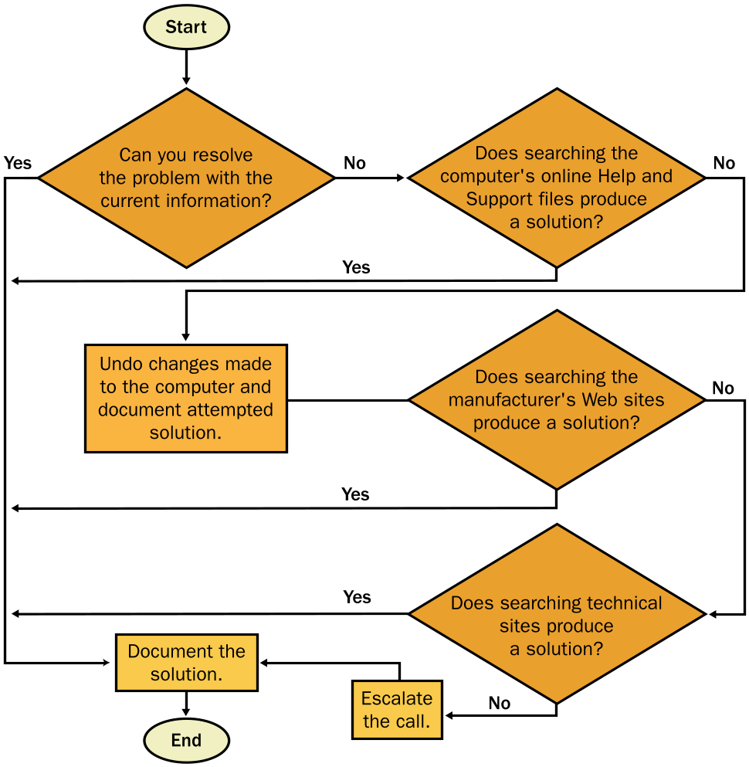
UNDERSTANDING GENERAL TROUBLESHOOTING PROCEDURES
Chapter 1: Introduction to Desktop Support
Notes:
Talk about the difference between using scripts to solve problems (such as in a call center) and performing hands-on troubleshooting. Go over the troubleshooting steps in the textbook with the class.

Slide 18
LOCATING THE ANSWERS
Chapter 1: Introduction to Desktop Support
Help And Support Center
Company Documentation
Manufacturers’ Web Sites
The Microsoft Knowledge Base
TechNet
Newsgroups
Notes:
Explain to the students that there are a number of places where they can search for solutions when troubleshooting a computer problem. Explain which types of problems would best utilize each of the tools listed on the slide.

Slide 19
ATTEMPTING SOLUTIONS
Chapter 1: Introduction to Desktop Support
Note current settings so that you can change them back if necessary
List possible solutions
Back up the user’s data, and create a system restore point
Document each attempted solution and the results
Attempt only one solution at a time
Notes:
Stress the importance of protecting user data above all else. DSTs should always make sure that there is a current backup of the user’s data before attempting any solutions. Also discuss undoing any changed settings before attempting the next solution.

Slide 20
DOCUMENTATION OF THE PROBLEM
Chapter 1: Introduction to Desktop Support
Record the date and time
Identify the user
Identify the computer
Explain the problem
Record each attempted solution and the results
Record when the issue is resolved and how long it took to resolve it
Notes:
Discuss the importance of documentation. Recommend that students create their own personal knowledge base of solved problems if the company they work for doesn’t already provide such a system.

